Slide 1
CORONAVIRUS PANDEMIC
AND ITS IMPACT ON UNITED STATES AND CHINA’S ECONOMY
We will analyze the impact the Wuhan Coronavirus pandemic
is having on US and Chinese stock markets.
Our results will help predict a way to manage portfolios during a pandemic.

Slide 2
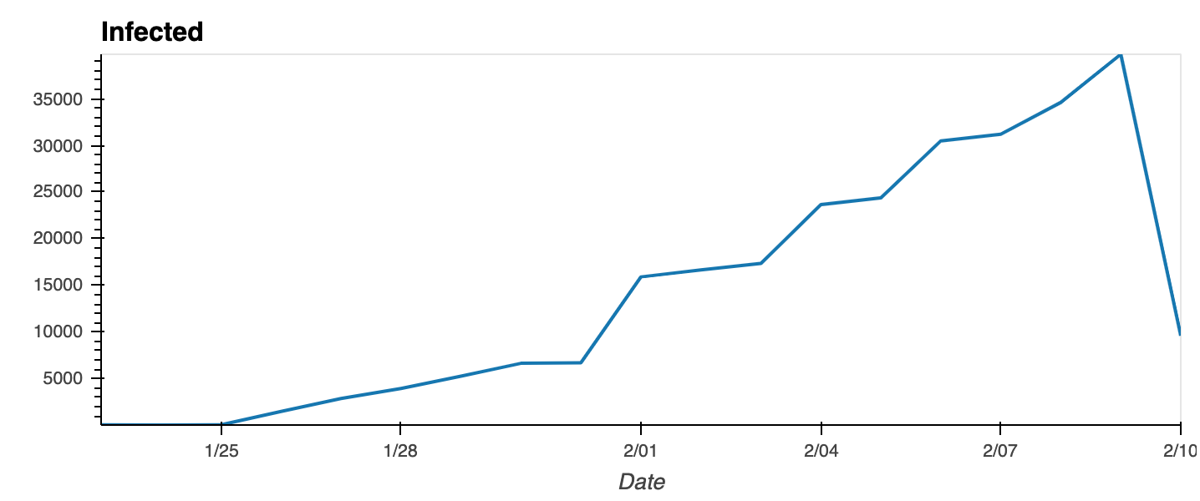
The Wuhan-centered outbreak, which first began in December 2019, is expected to continue to spread widely within China, with additional cases exported to other countries.

Slide 3
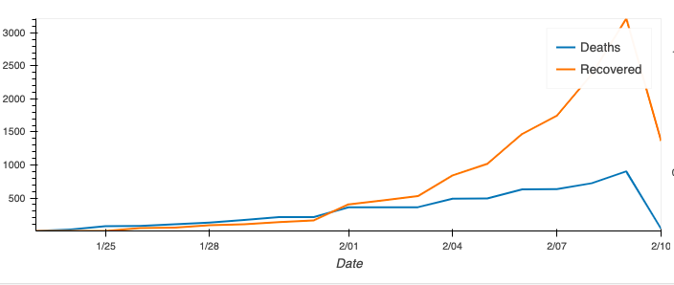
Death and Recovery Rates Per Day in China

Slide 4
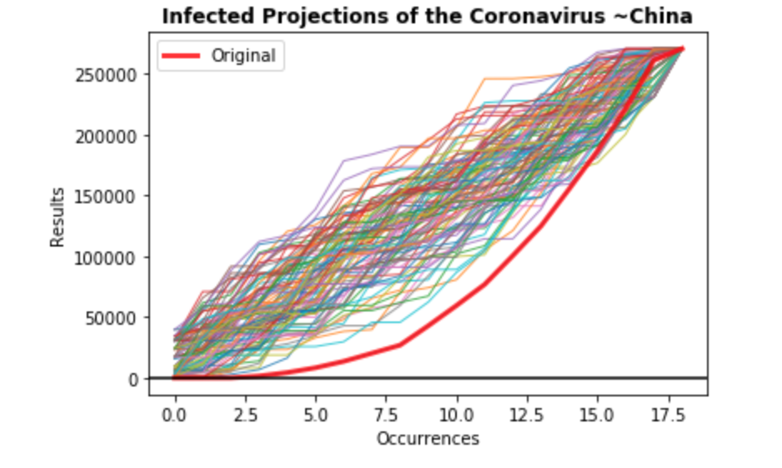
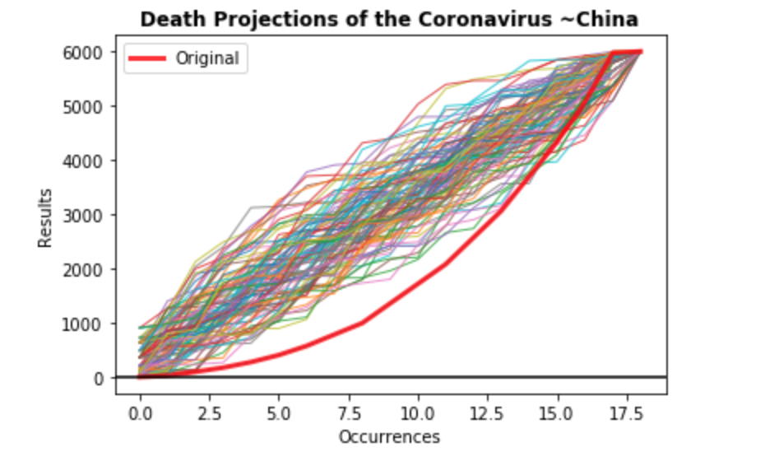
We projected the growth of the ‘Infected’ and ‘Death’ rates for China

Slide 5
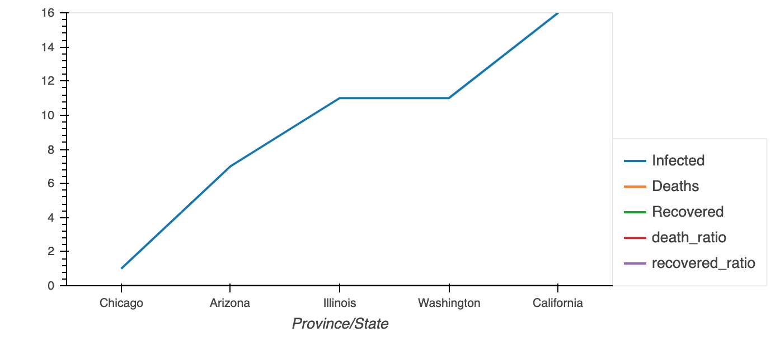
The risk remains very low to the United States with only TWELVE ‘Infected’ cases and ZERO ‘Deaths’ reported to this day.

Slide 6
We determined the top 5 markets affected by the outbreak in the
US and CHINA

Slide 7
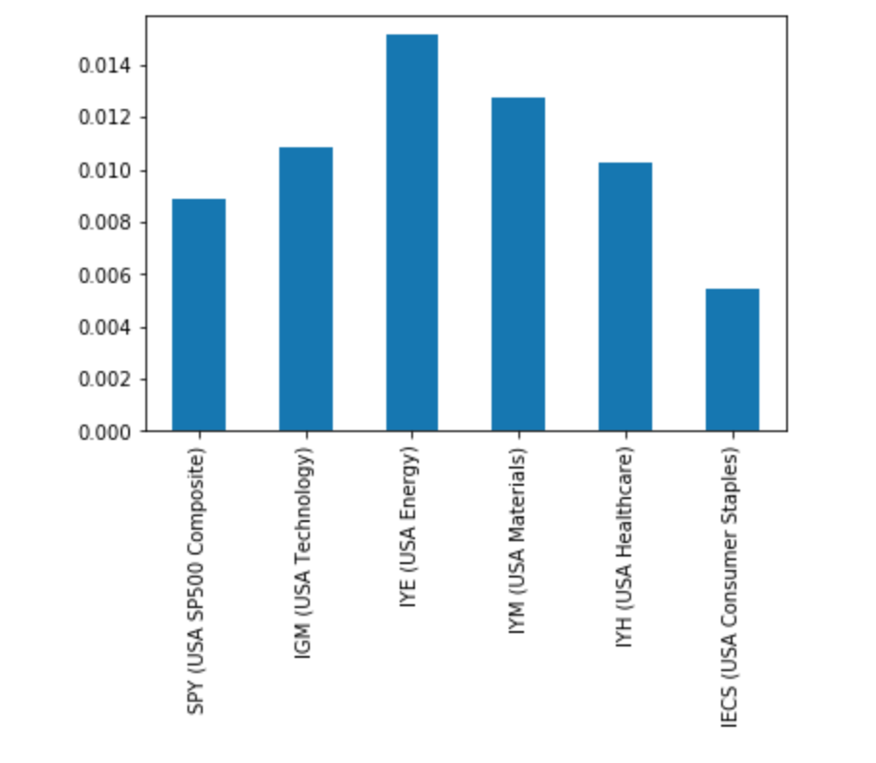
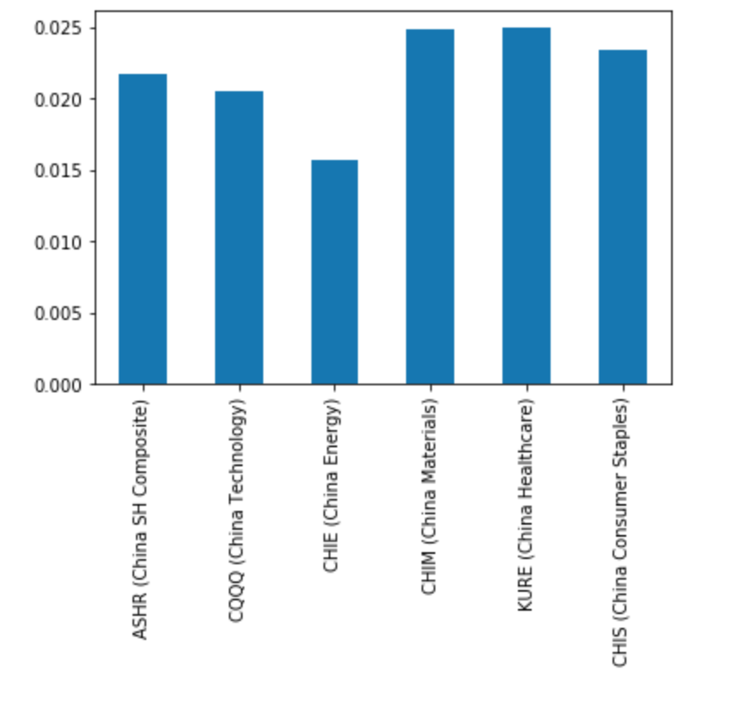
TECH, ENERGY, MATERIALS, HEALTHCARE AND CONSUMER STAPLES

Slide 8
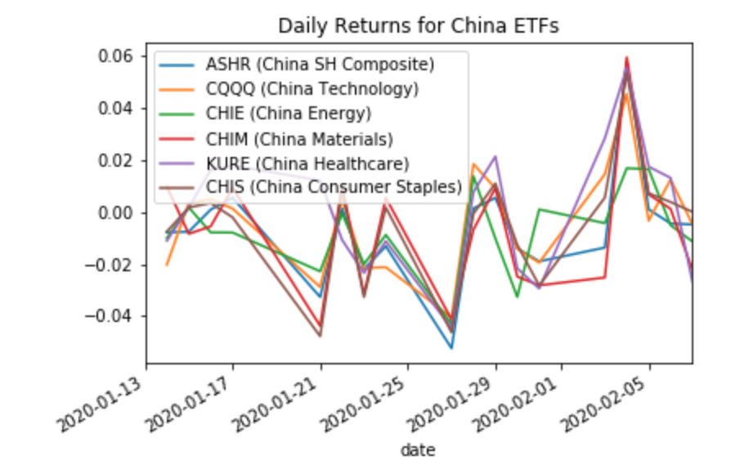
We took a look at China’s Top 5 Markets at the beginning of the outbreak to decide which were affected negatively and positively.

Slide 9
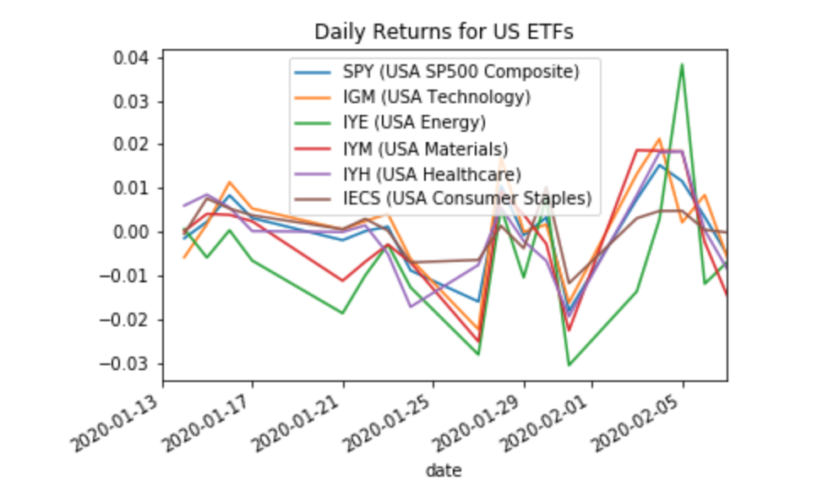
We also took the Daily Returns for the Top 5 US Stock Markets and SP500 to determine any correlations between the growth of the virus and the increase or decrease of stock value.

Slide 10
Correlations between
Coronavirus VS China and US

Slide 11
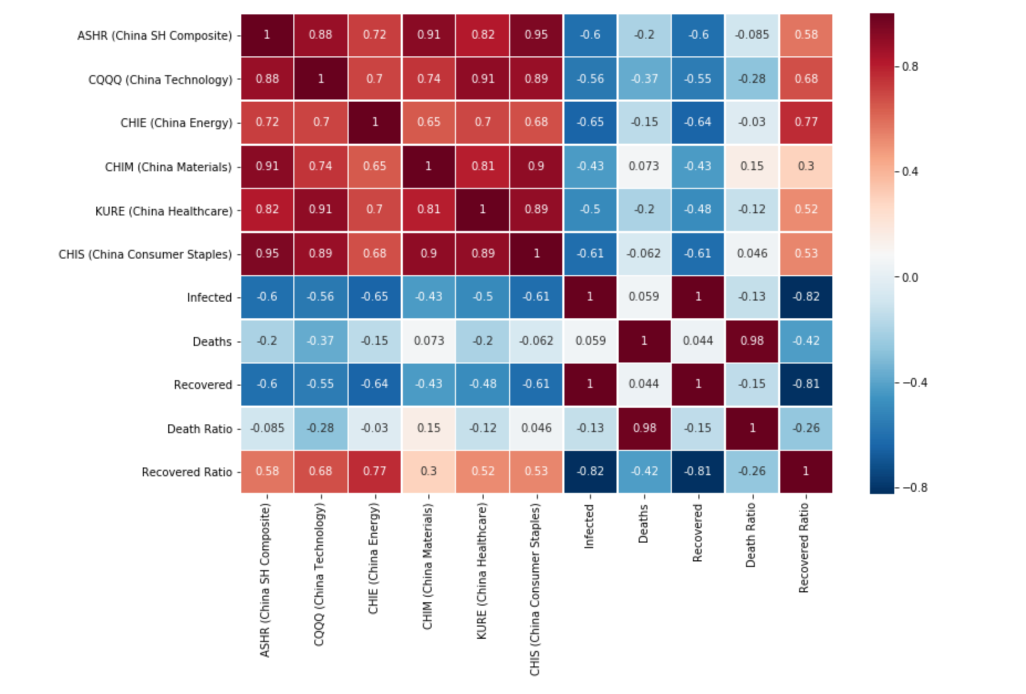

Slide 12
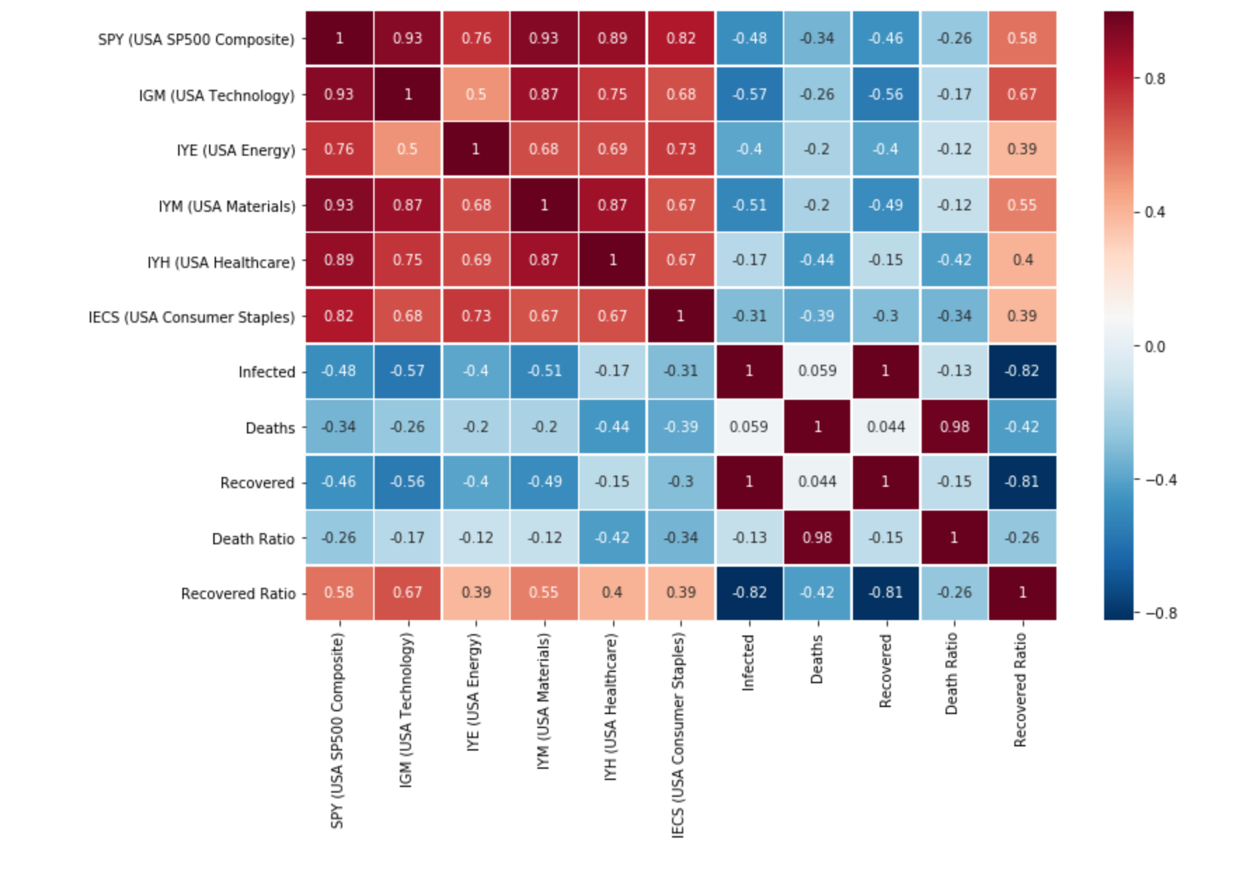

Slide 13
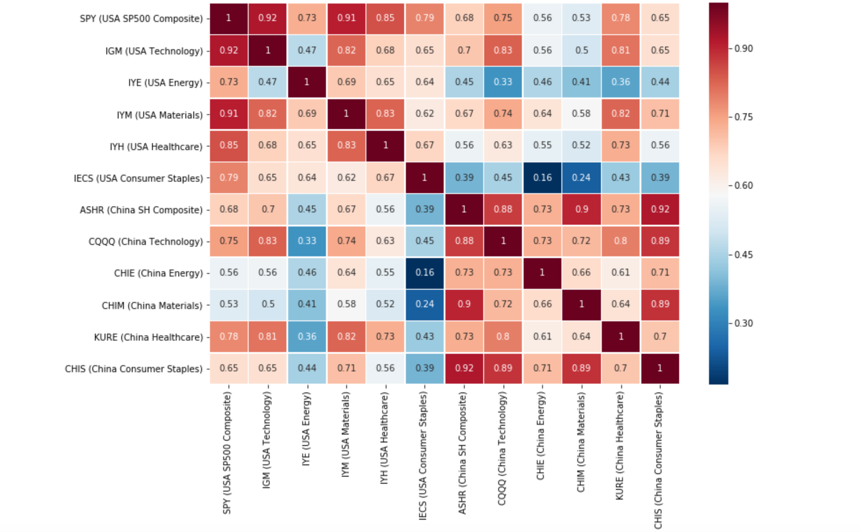
Correlation between China and US Top 5 Stock Markets

Slide 14
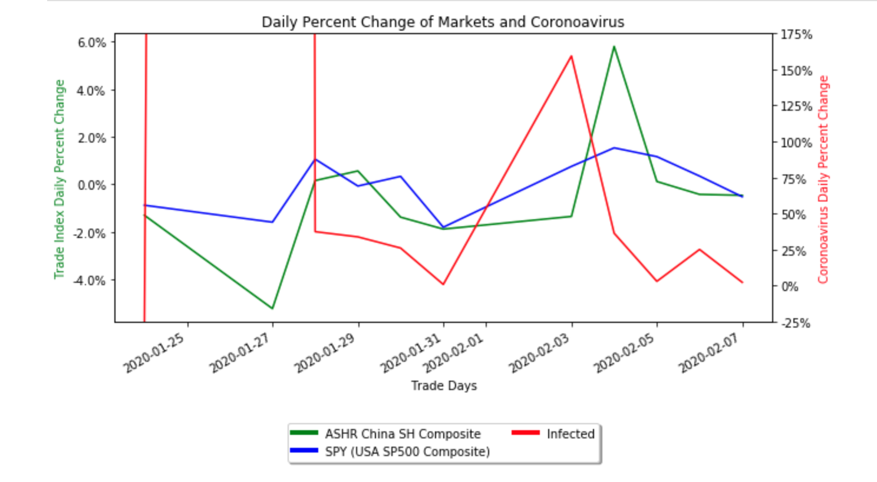
Infection Rate to Market Change

Slide 15
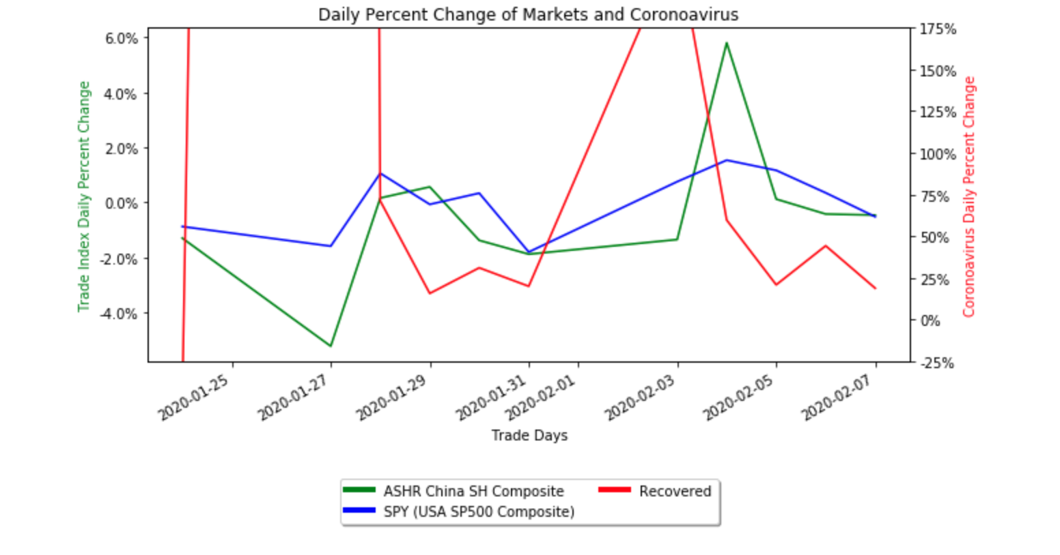
Recovery Rate to Market change

Slide 16
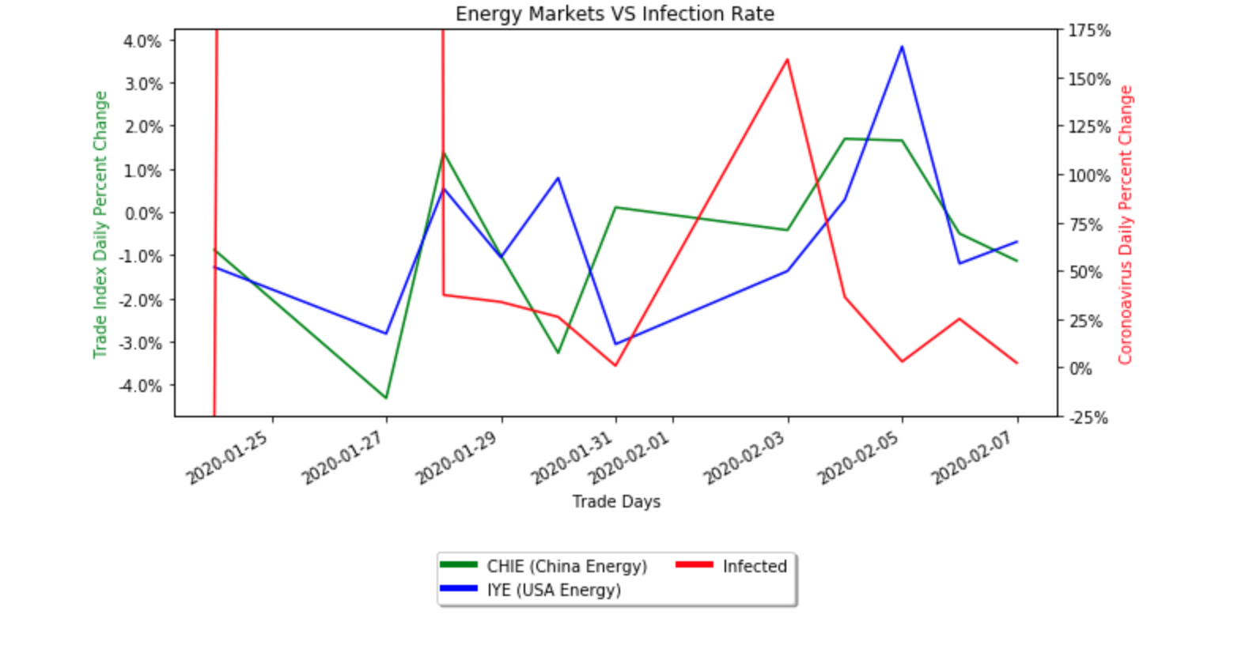
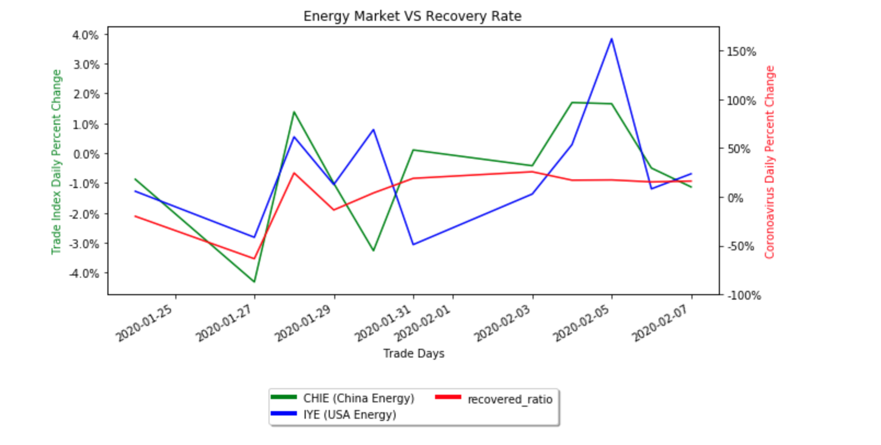
ENERGY

Slide 17
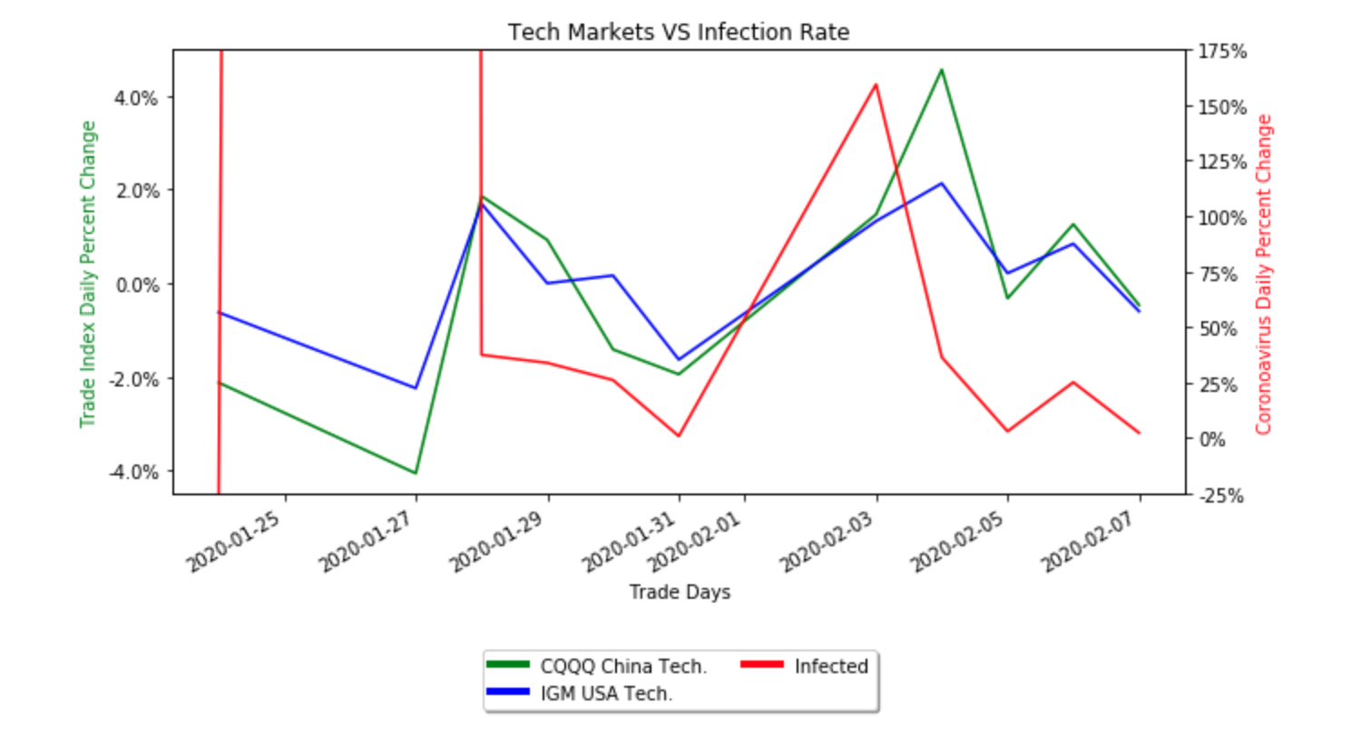
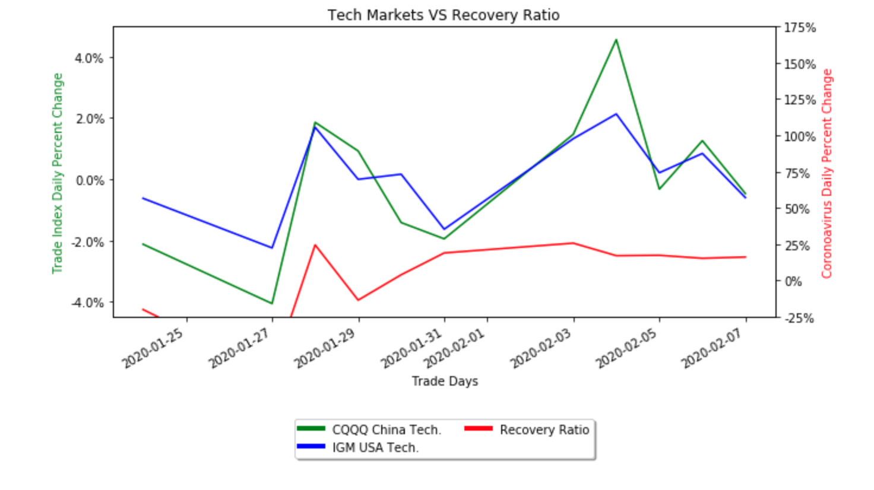
TECH

Slide 18
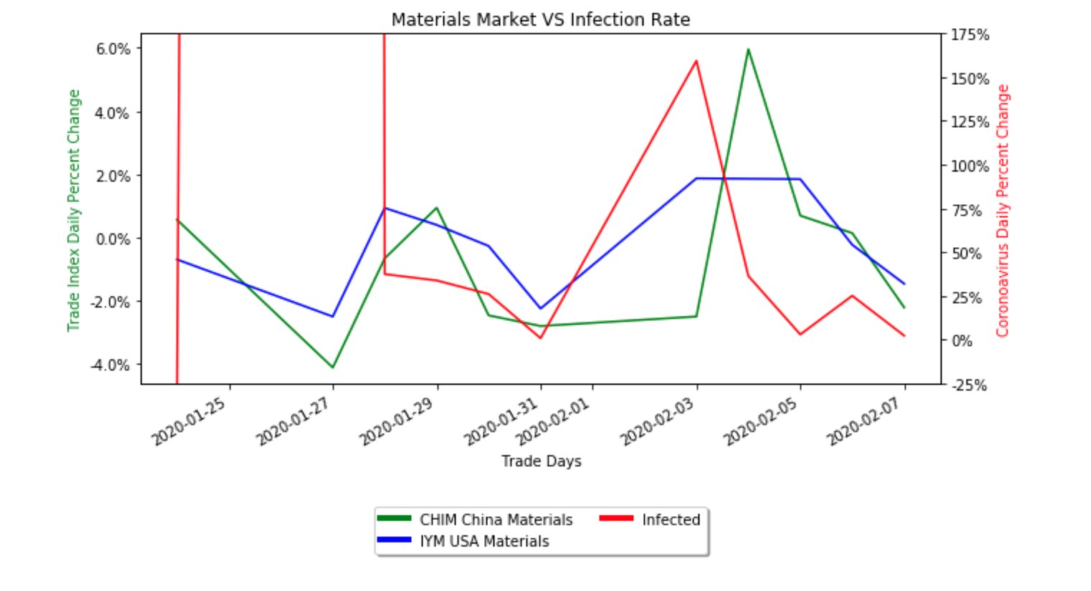
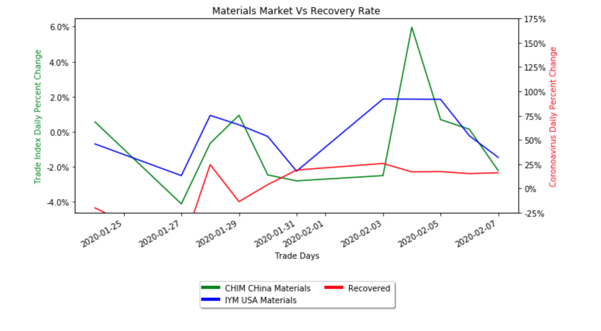
MATERIALS

Slide 19
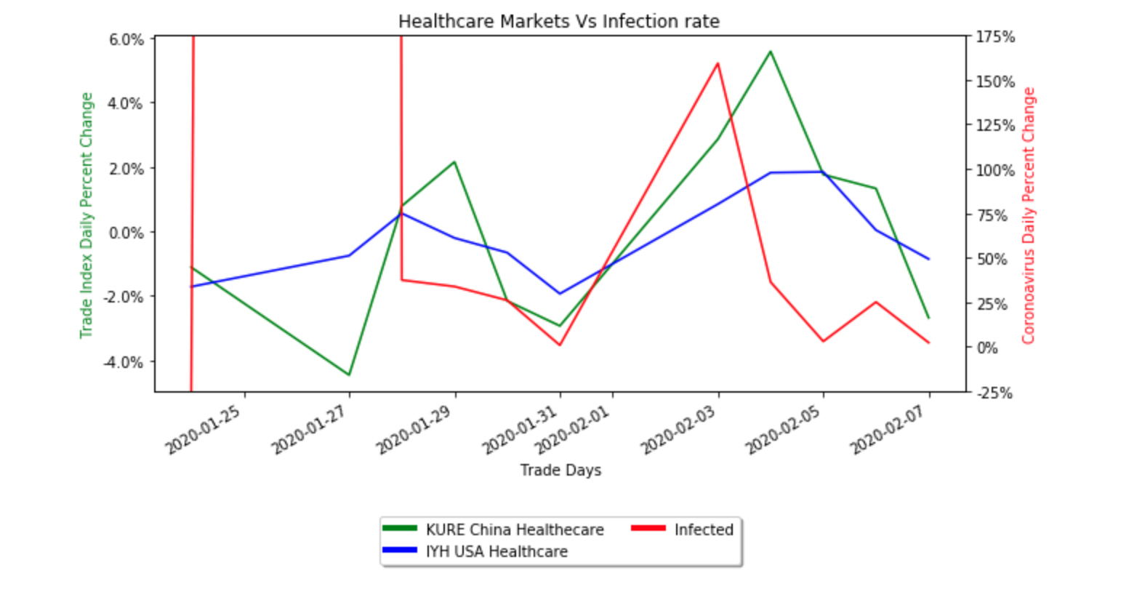
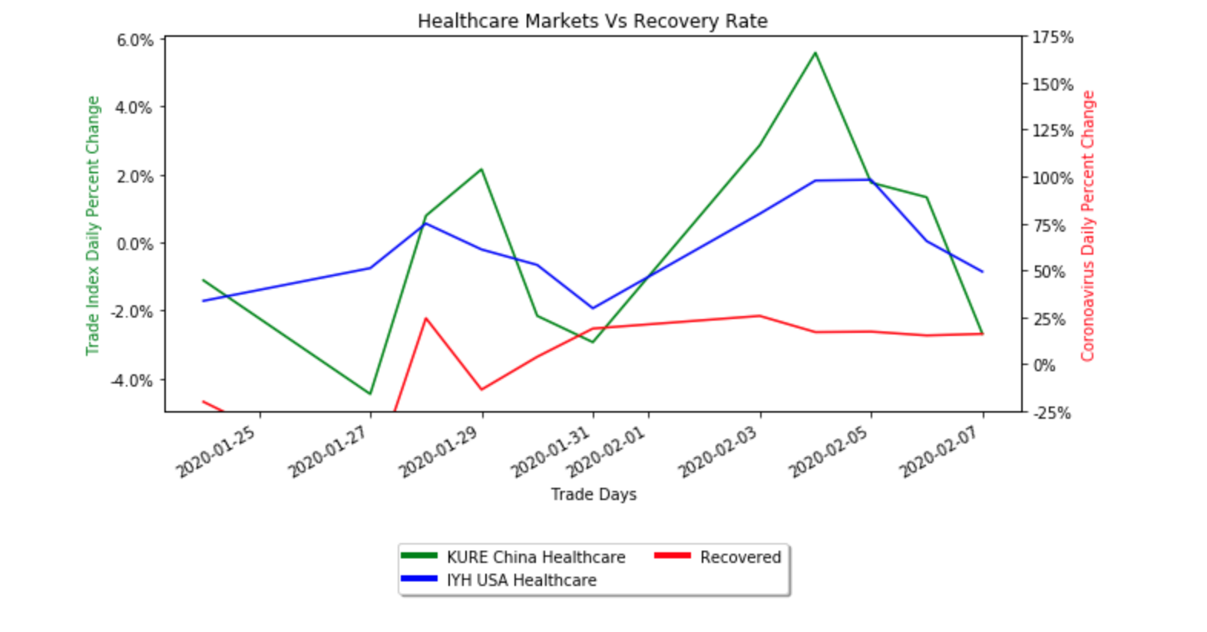
HEALTHCARE

Slide 20
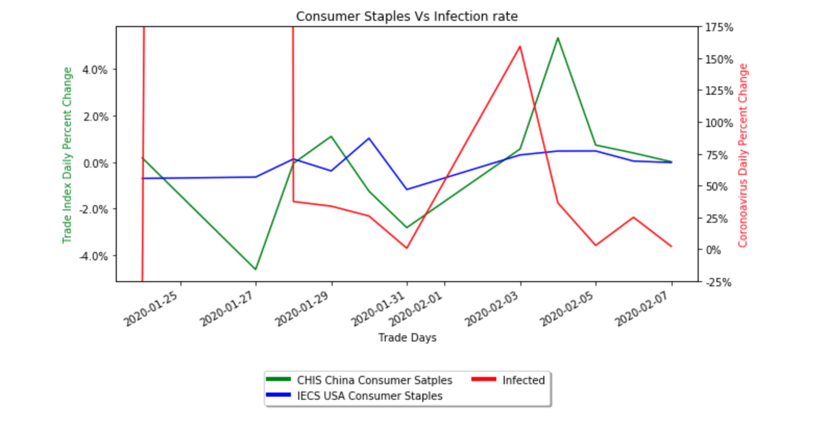
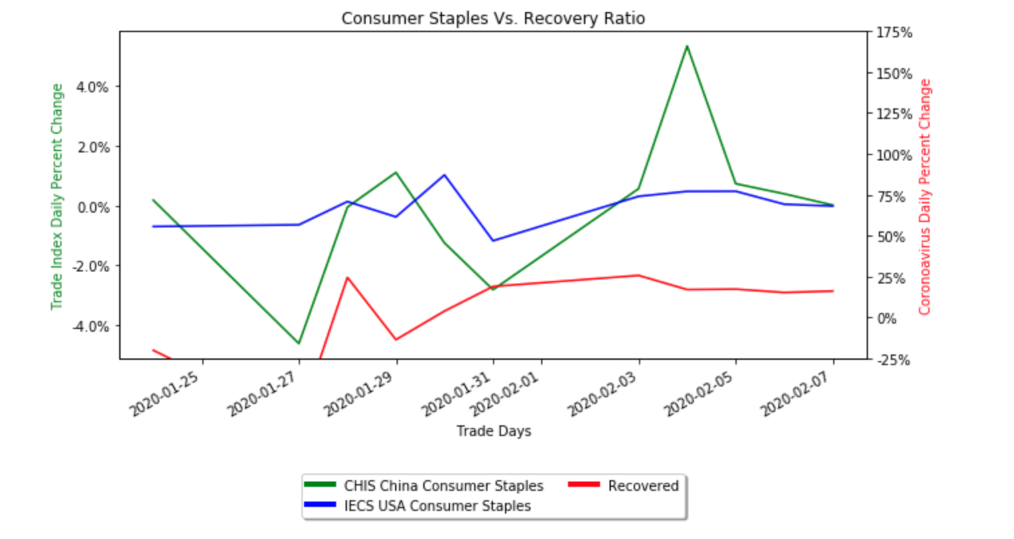
CONSUMER STAPLES

Slide 21
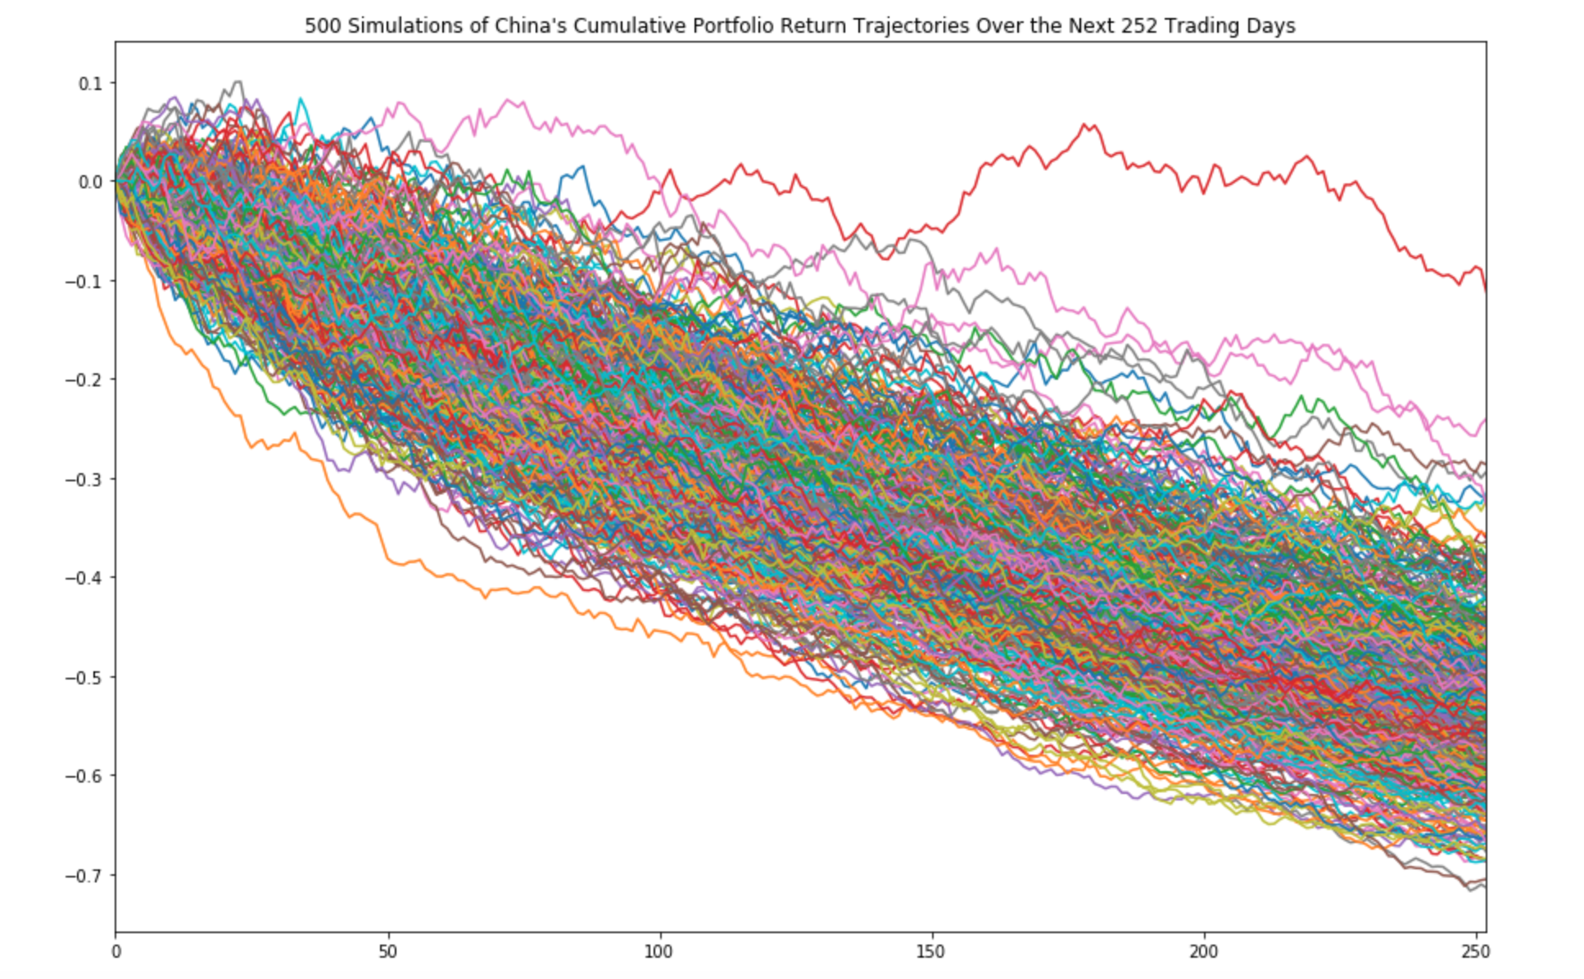
Montecarlos Simulations for China

Slide 22
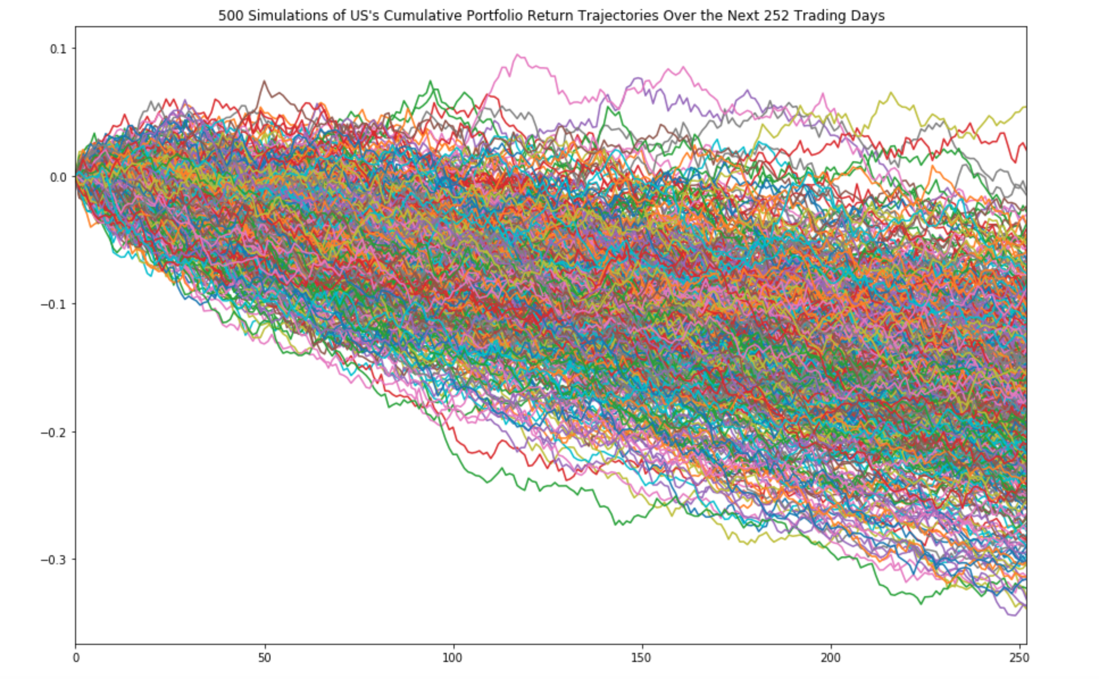
Montecarlos Simulations for US

